Slide 1

Salary Hike
Analysis

Slide 2
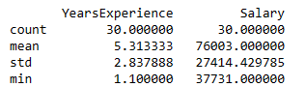
Objective
Analyze the years of experience & salary according to it base on the given data. By using this data will find out the co-relation between years of experience & salary

Slide 3
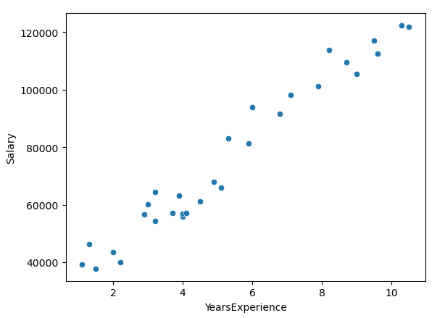
Solution
After analyzing the data we came on the conclusion as the years of experience increases the salary also increases.
same can be seen in below graph plot.

Slide 4
Business impact
As the years of experience increased salary also increased for employee & it will create the finical impact on the company’s budget

